Slide 1

Programmazione di Sistemi di IoT
Sense EMOTIONs
Shimmer & GSR sensor
Docente
Prof. Giancarlo Fortino
Studenti:
Enrico Ubaldino 207017
Matteo Aloi 207052
Anno accademico 2019/2020

Slide 2
Outline
Introduction
Analisys
Implementation
Testing phase
State of Art
Interest and Research

Slide 3
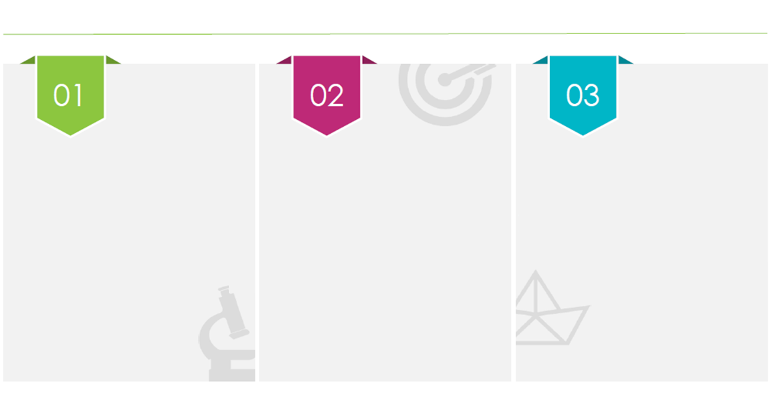
Why?
It allows us to find out how the human ASN affects the conductivity of the skin.
Understand how users interact emotionally.
Create biofeedback.

Slide 4
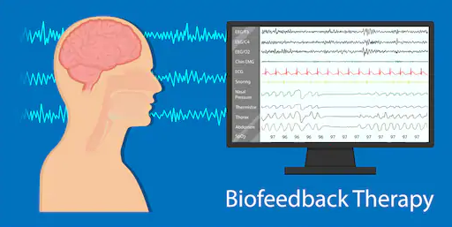


Goal
Questa foto di Autore sconosciuto è concesso in licenza da CC BY-SA

Slide 5
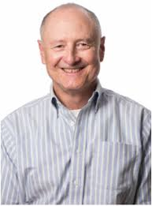
What is emotion?
"Everyone knows what an emotion is, until asked to give a definition"
James A. Russell

Slide 6
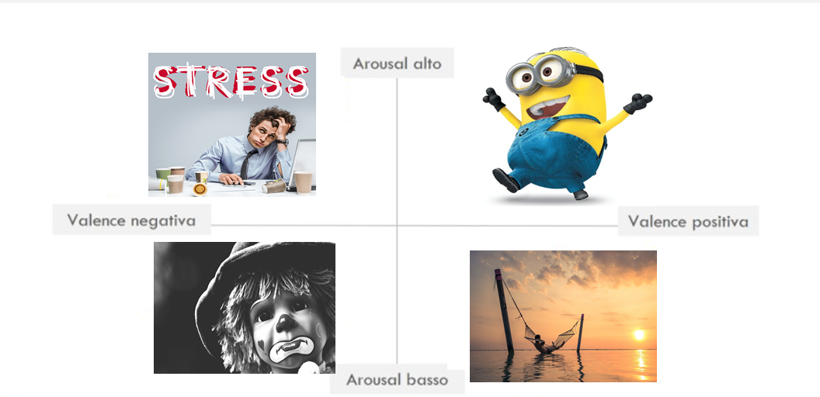
Russel Model

Slide 7
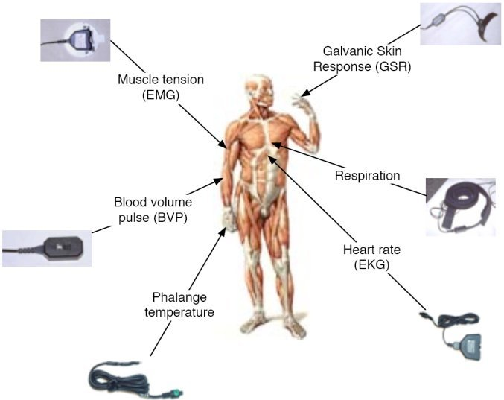
Biosignal

Slide 8
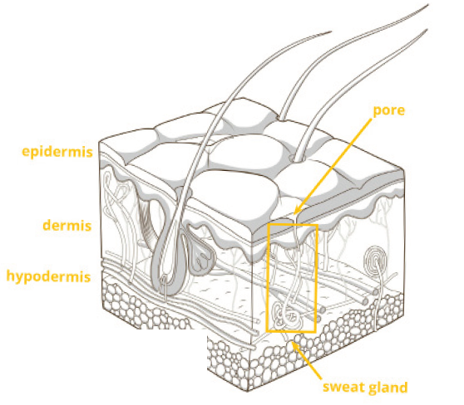
Galvanic Skin Response (GSR)

Slide 9
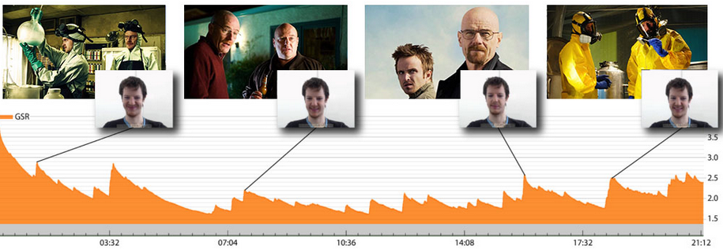
From bio-signal to emotional states
Source: Imotions, Galvanic Skin Response

Slide 10
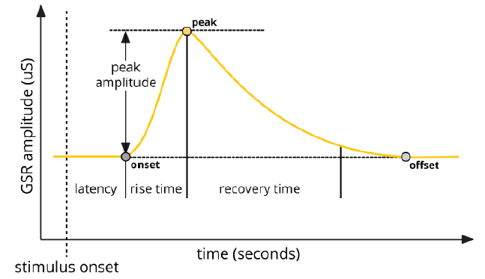
GSR Signal
Source: Imotions, Galvanic Skin Response

Slide 11
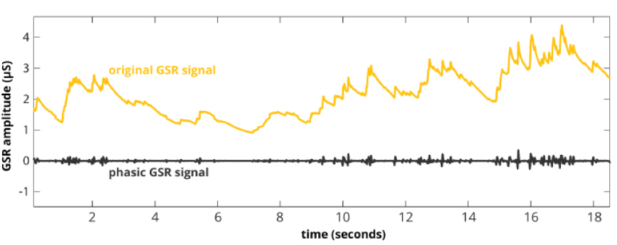
Analisys
Source: Imotions, Galvanic Skin Response

Slide 12
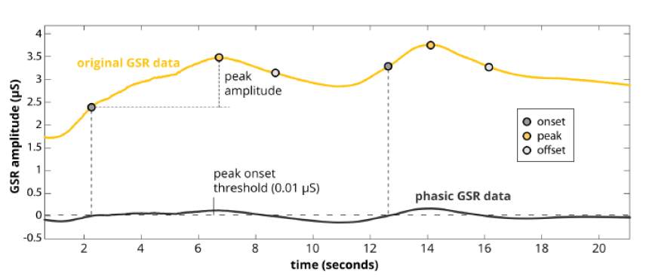
Peaks Search
Source: Imotions, Galvanic Skin Response

Slide 13
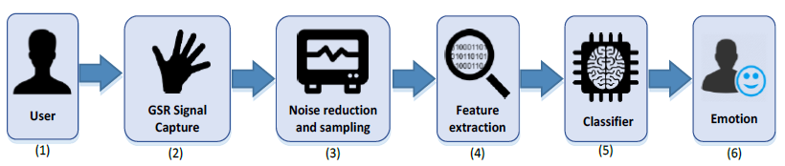
Emotion Recognition Pipeline

Slide 14
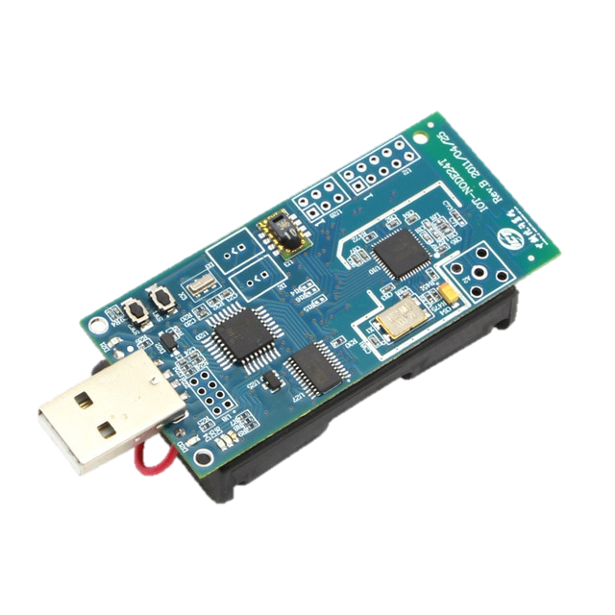
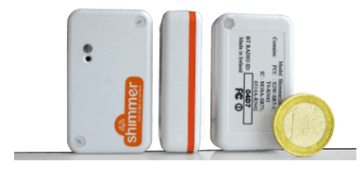

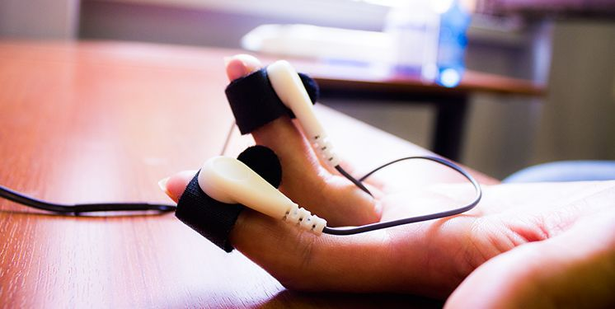
GSR Signal Capture

Slide 15

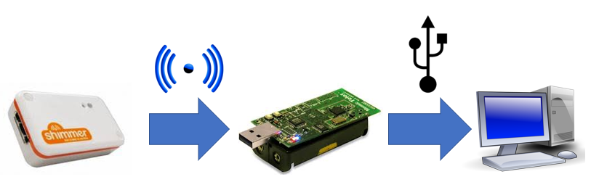
Communication

Slide 16
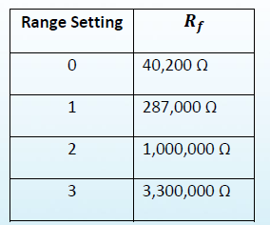
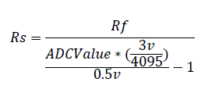
GSR Formula

Slide 17


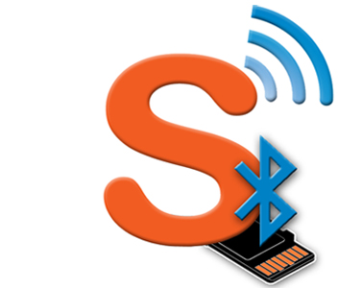
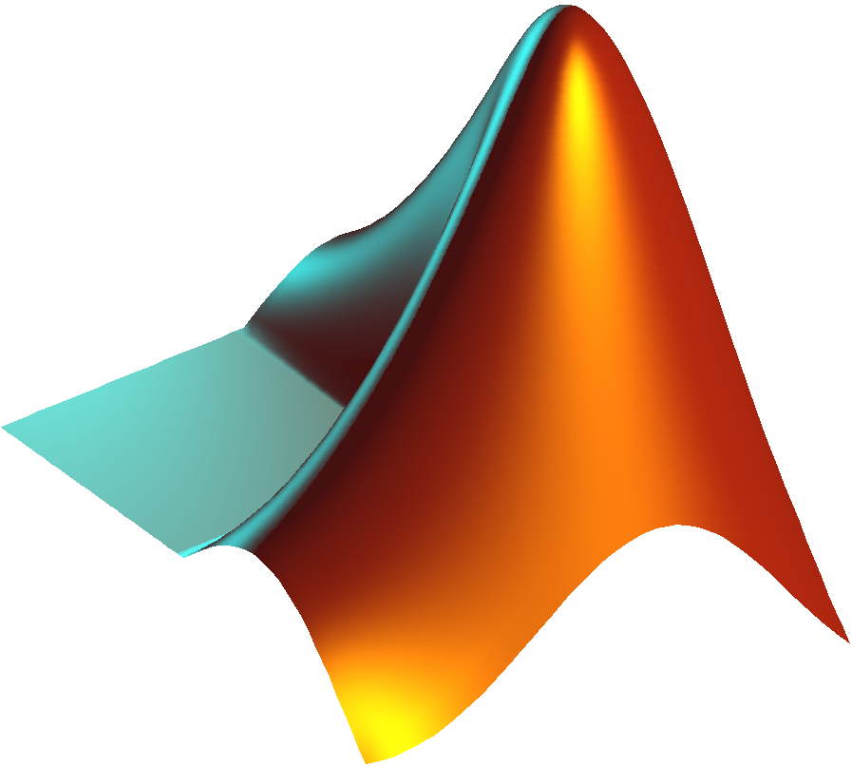
Software

Slide 18
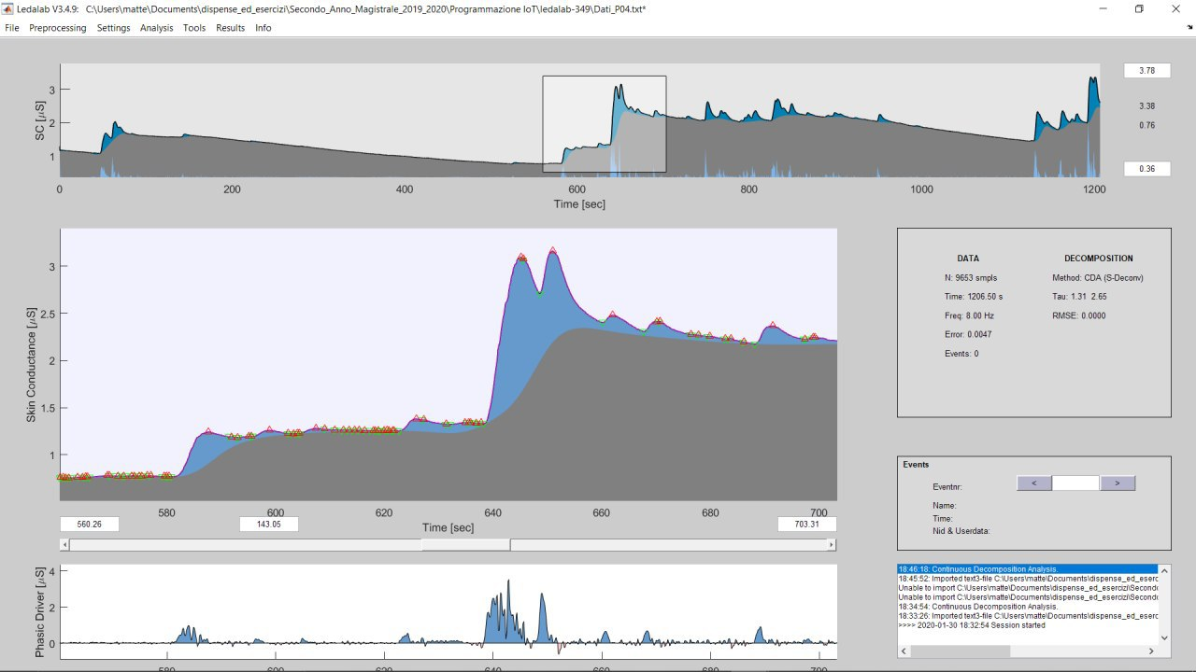
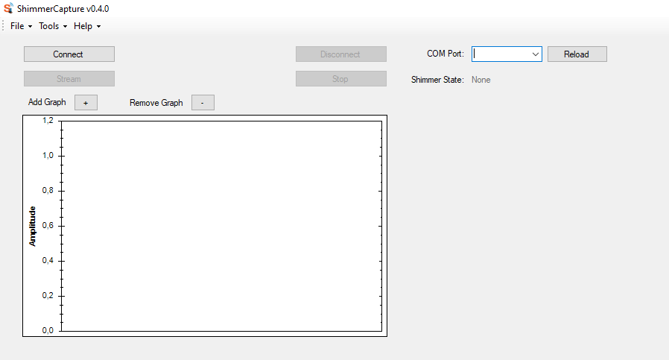
Data Validation
Ledalab
Shimmer Capture

Slide 19



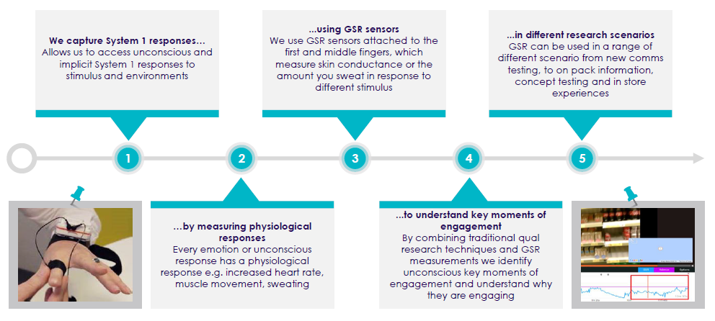
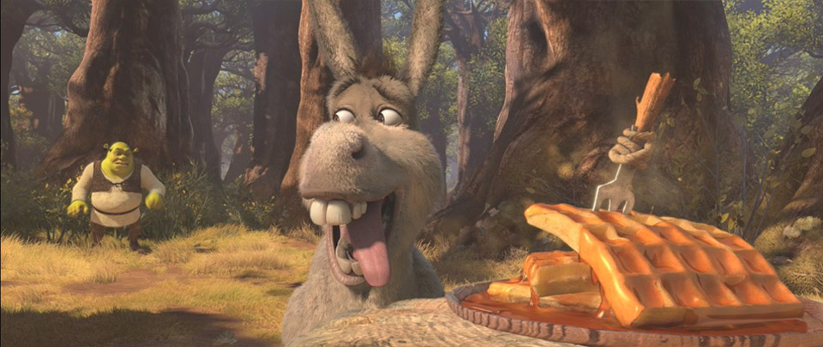
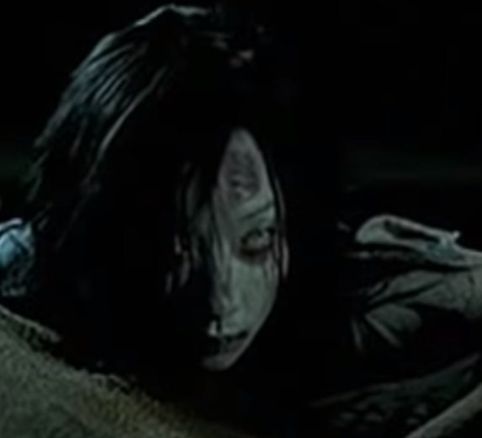
Training Process

Slide 20
Noise and Sampling time
Setup | Value
Filter | Median [HF]
Sampling Frequency | 10 [Hz]
Windows Size | 80
Shift Size | 40

Slide 21
Feature Extraction
Feature:
ADC Value;
Min;
Max;
Mean;
Median;
Dev.Standard;
Skin Resistance;
Phasic Driver.

Slide 22
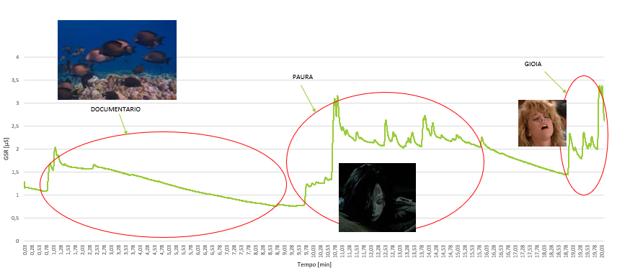
Processing

Slide 23
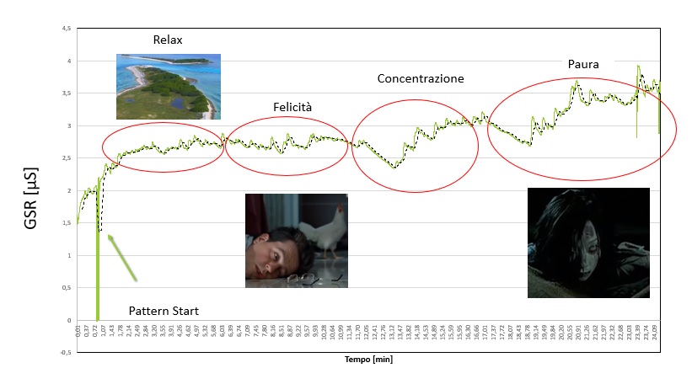
Processing

Slide 24
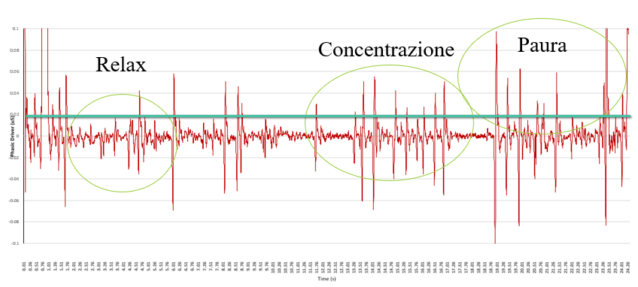
Phasic Driver

Slide 25
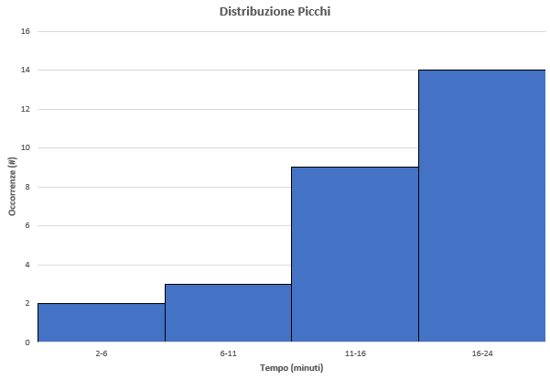
Peak Distribution

Slide 26

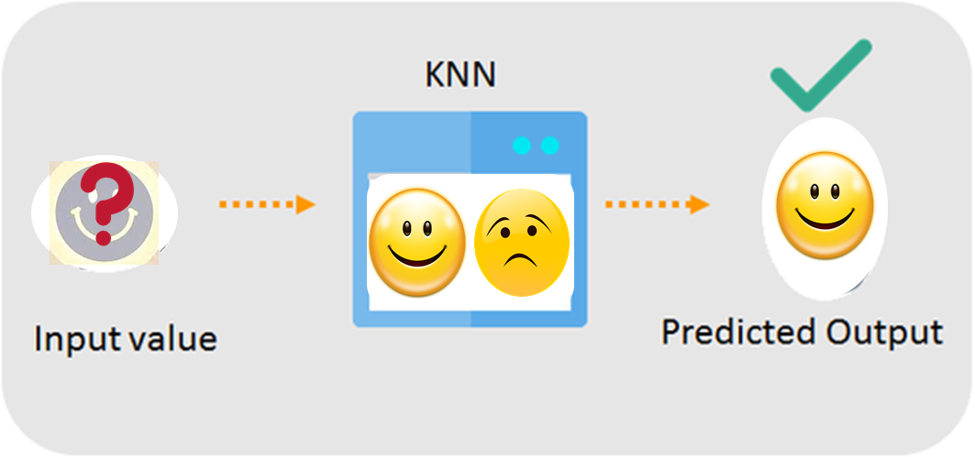
Classificator

Slide 27
Classificator KNN
Proprietà | Valore
Class | Paura, Neutrale, Gioia
Accuracy | 0.9799
Error Rate | 0.0201

Slide 28
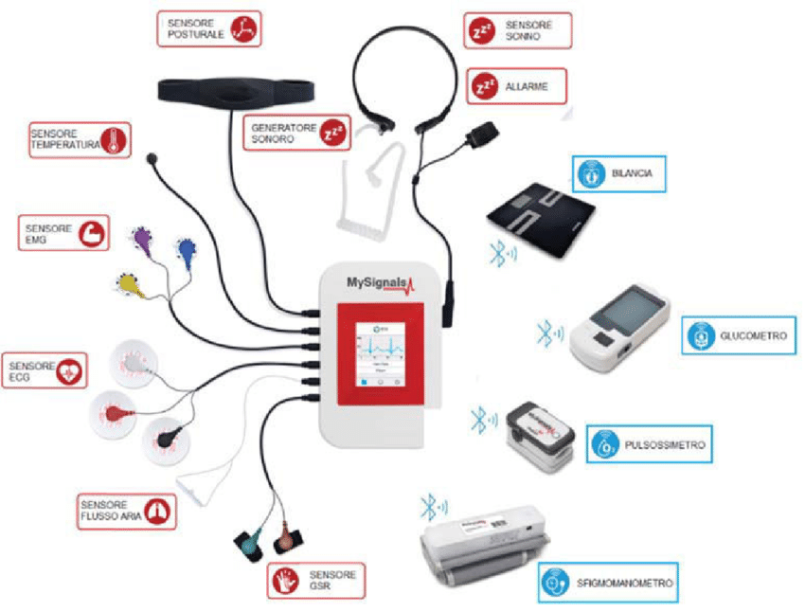
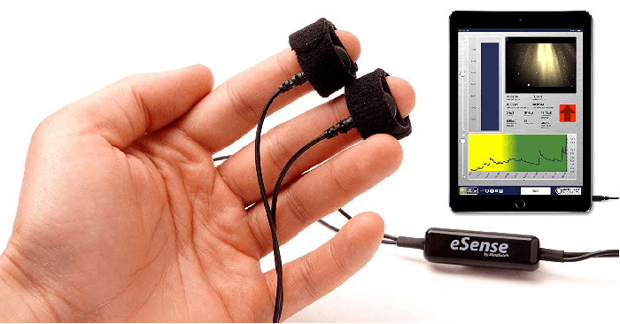
State of Art
eSense
MySignals

Slide 29
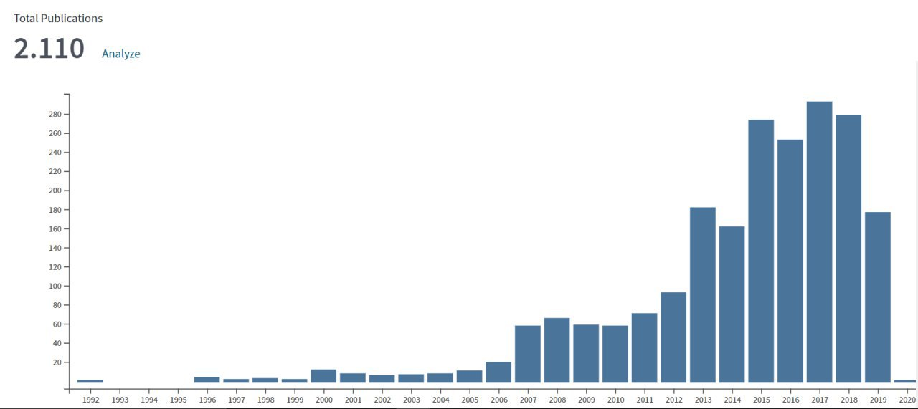
Interest and Research
Source: www.webofknowledge.com

Slide 30
Thanks for your attention

